Slide 1

THINKING CRITICALLY ABOUT UNHEALTHY FOOD AND DRINK MARKETING AND THE WELLBEING OF CHILDREN AND YOUNG PEOPLE
Analysing unhealthy food and drink advertising to children and young people
Notes:
Sally– introduction to the workshop – purpose

Slide 2
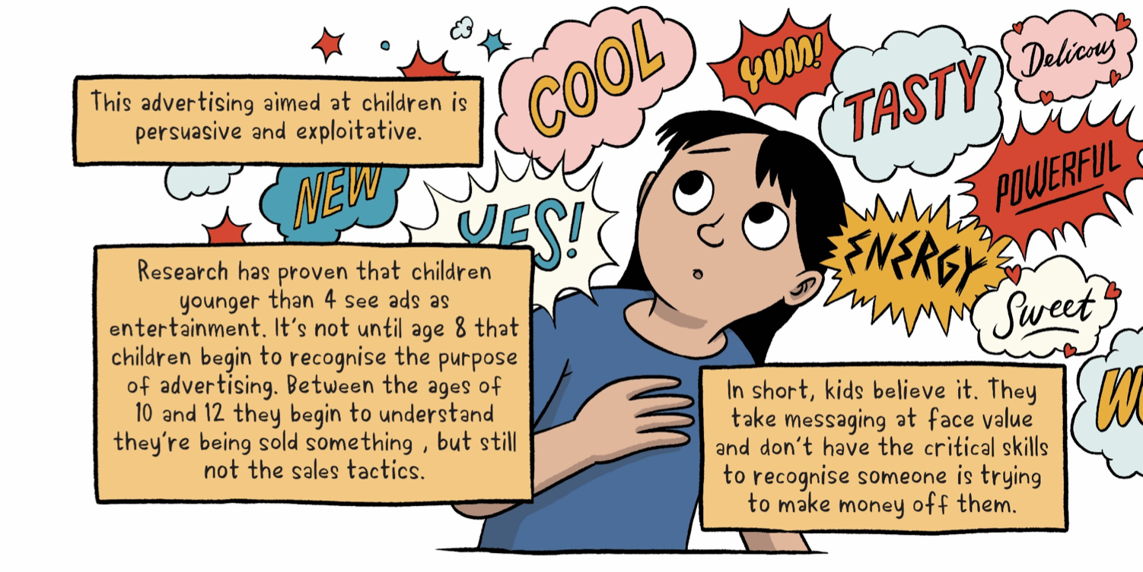

Notes:
Sally – introduction to the research

Slide 3

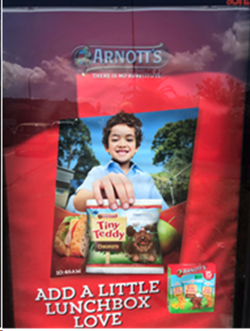
Marketing of unhealthy food and drink contributes to the worldwide increase in childhood obesity by shaping children’s dietary preferences and encouraging the repeated purchase and consumption of foods that do not meet nutritional guidelines.
NZ children are exposed to unhealthy food marketing over 27 times a day across multiple settings,excluding screens and food stores.This exposure is more than twice their average exposure to healthy
food marketing.

Slide 4

Notes:
Angela
Self-regulatory- what we have now
One of the key pieces of work we want to do is encourage complaints to the ASA- numbers are powerful- more complaints shows that the system isnt working, and we can gather more information about the industry arguments. Self-regulatory system- a set of codes. When complaints are received they are reviewed by the complaints board The ASCB is a nine member board, with five public members and four industry members.

Slide 5


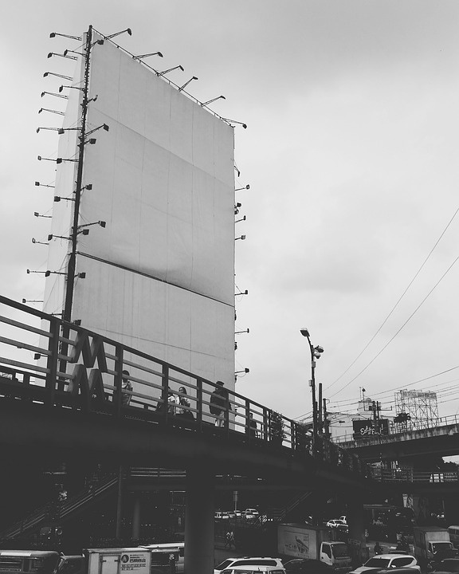
Settings
Print, digital and outdoor advertisements (billboards, bus shelters, YouTube, social media, television, mail advertising)
Notes:
This Code does not apply to product packaging, bona fide news, reviews, editorial and broadcast programmes
Lack of restrictions where children and yong people gather

Slide 6
ASA Codes
Children and Young People's Code
Advertising Standards Code
Children means all persons below the age of 14 years
Young people means all persons who are at least 14 years but under 18 years
Take note of the principles, rules, guidelines, spirit and intention of the codes
Best interests of the child shall be a primary consideration
Notes:
Angela
In interpreting the Code, emphasis will be placed on compliance with both the principles and the spirit and intention of the Code. The Rules are examples, by no means exhaustive, of how the Principles are to be interpreted and applied. It is possible for advertising to be in breach of one or more of the Principles in the Code without being in breach of a specific Rule. The Complaints Board will have regard to all relevant matters, including the overall impression conveyed, the context and target market.
protect children pursuant to the UNCROC “the best interests of the child shall be a primary consideration”, “appropriate Rules for the protection of the child from information and material injurious to his or her well-being.”

Slide 7

Children and Young People's Code
Social responsibility: Advertisements targeted at children or young people must not contain anything that is likely to result in their physical, mental or moral harm and must observe a high standard of social responsibility.
Truthful presentation: Advertisements must not by implication, omission, ambiguity or exaggerated claim mislead or deceive or be likely to mislead or deceive children or young people, abuse their trust or exploit their lack of knowledge.
Sponsorship advertising: Occasional food and beverage sponsorship advertising must not target children and a special duty of care must be exercised for young people.
Social Responsiblity
Truthful Presentation
Sponsorship Advertising
Notes:
Angela
broadcast media, digital media, print advertisements, billboard or outdoor advertisements
Definition ofAdvertisement“Advertising andAdvertisement(s)” means any message, the content of which is controlled directly or indirectly by the advertiser, expressed in any language and communicated in any medium with the intent to influence the choice, opinion or behaviour of those to whom it isaddressed.
In interpreting the Code, emphasis will be placed on compliance with both the principles and the spirit and intention of the Code.

Slide 8
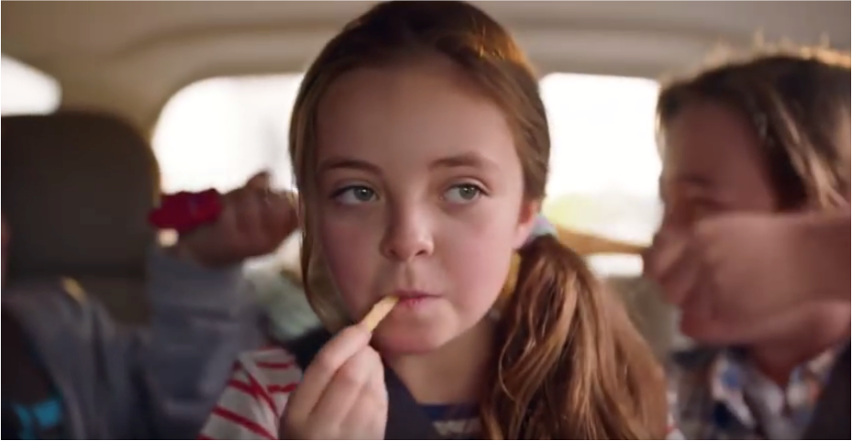
Food and Beverage Classification System
Occasional Food and Beverage Products
Food and beverage products which are high in fat, salt or sugar and classified under the Food and Beverage Classification System (FBCS) as being intended for occasional consumption.
Separate criteria for schools and early childhood centres
Notes:
Occassional
Sometime
Everyday

Slide 9
Definition of targeting
PRODUCT
Nature and intended purpose of the product or service being promoted is principally or generally appealing to children or young people
PRESENTATION
Presentation of the advertisement content (e.g. theme, images, colours, wording, music and language used) is appealing to children or young people
AUDIENCE
Expected average audience at the time or place the advertisement appears includes a significant proportion of children or young people
Notes:
Angela
is determined by the context of the advertisement and the relationship between the following three criteria
Product, presentation, placement
Significant proportion- 25% of the expected audience.
Child viewing time zones - 4-6pm . 3. Content with significant appeal to children such as programmes, artists, playlists, video, movies, and magazines. 4. Locations where children gather (e.g. schools, school grounds, pre-school centres, playgrounds, family and child clinics and paediatric services and during any children’s sporting and cultural events)

Slide 10
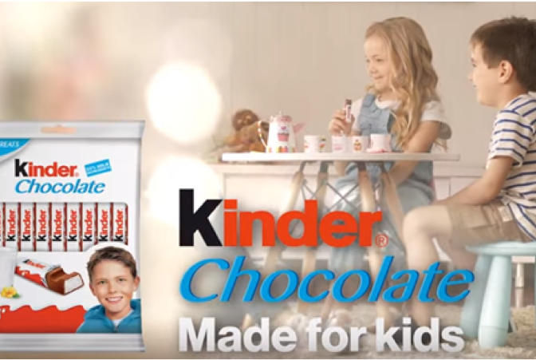


What Sets Us Apart?
CRITERIA
  Advertising must not provide an unrealistic sense of body image or promote an unhealthy lifestyle.
  Popular characters and celebrities must not be used irresponsibly in ads for occasional foods.
  Occasional food/beverage ads must not target children
  Ads must show appropriate food portion size for age and for one eating occasion
  Ads must not encourage acting promptly to purchase or buying excessive amounts

Slide 11
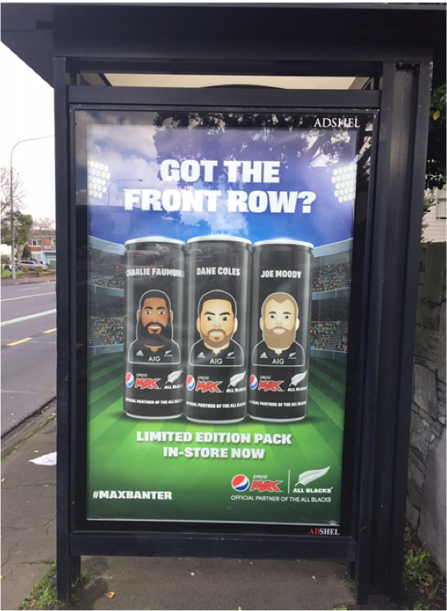
What Sets Us Apart?
CRITERIA
  Ads must not mislead as to the potential physical, social or mental health benefits from consumption
  Sponsorship ads must not show an occasional food or beverage product, or such product’s packaging, or depict the consumption of an occasional food or beverage product.

Slide 12
Activity: Evaluate the appropriateness of an unhealthy food or beverage ad
THE AD
OCCASSIONAL
BREACHES
WHY
Format of the ad (eg print ad, billboard, video (commercial)
Brief description of the ad – imagery, catch phrases, music, etc
Food or beverage advertised
Is it an occasional food or beverage?
Do you think the advertisement targets children or young people DIRECTLY or INDIRECTLY, or not at all?
Which rules/principles does the ad breach and why?
Notes:
Sally

Slide 13
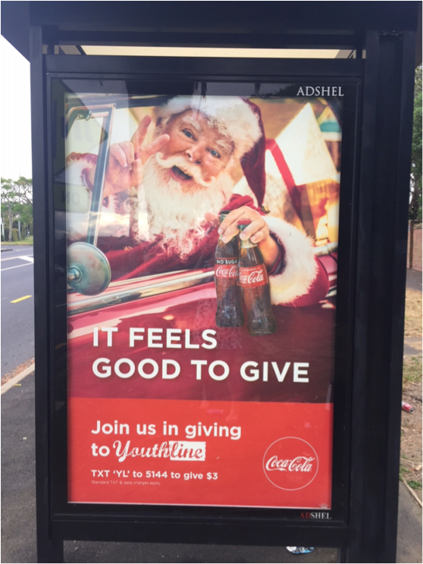
Activity: Evaluate the appropriateness of an unhealthy food or beverage ad
Coca Cola advertisement example
Out of home bus shelter ad
Complaint 17/454
Notes:
Sally – introduce activity
Play videos

Slide 14
Coca Cola complaint, complaint decision and advertiser response
Breaches highlighted by complainant: In breach of principle 1 and rules 1(h) 1 (i) 1(j), principle 3 and rule 3(a)
Breaches determined by ASA complaints board: Partially upheld. Ruled in breach of principle 1, rule 1(i), principle 3 and rule 3(a), did not breach rules 1(h) and 1(j).
WE COMPLAINED THAT
PRINCIPLE
COKE REPLY
ASA RULING
Principle 1, 1 (h), 1 (i), 1(j)
Not likely to result in physical, mental of moral harm, high standard of social responsiblity
1(h)
Popular characters and celebrities to be used in a responsible manner
1 (i) Ads (incl sponsorship ads) must not target children or be placed where children are significant proportion of audience
1(j) Special duty of care to occassional beverage advertising to young people
Principle 3, 3(a) Sponsorship ads must not show an occassional food or beverage product
Both Coke and Coke No Sugar are occassional.
Santa Claus best loved characters by children. Holding bottles of cokes to appeal to children.
Bus shelter close to primary and secondary school- large numbers of children will view.
Irresponsible advertising despite good cause.
Sponsorship ad for Youthline containing ocassional beverages.
Coke No Sugar is a sometimes beverage
Purpose of Santa is to appeal to families, not to target children or young people
Not placed within 250m of main entrance of a school.
Median age of surrounding households 38.5 and 47.5
Relationship with Youthline a corporate partnership
Partially upheld- In breach of 1, 1(i), 3, 3(a)
Sponsorship ad which targeted children and young people. Full sugar Coke appeal to children, placement, recognition of Youhtline.
Primary concern occassional beverage not Santa Claus
Placement- lack of data- err on the side of caution.
.
.
Notes:
Sally

Slide 15
ACTIONS YOU CAN TAKE
Make a complaint to the Advertising Standards Authority (ASA) when you see ads for junk food that are aimed at children.
Talk to your local sports club about replacing junk food marketing within the grounds.
Talk to your local school board about reducing exposure to food marketing at school.
Speak with your Councillor and Local Board members about outdoor signs and council properties such as parks and recreation centres.
Other countries regulate this type of marketing – the UK, Ireland and South Korea. Contact your MP about regulatory changes.
Join the conversation on Twitter and Instagram and post ads aimed at children using the hashtag #dumpthejunknz.
Notes:
Angela

Slide 16
#dumpthejunknz
Commit to posting an inappropriate ad on Instagram or send through to:
healthyaucklandtogether@adhb.govt.nz

Slide 17



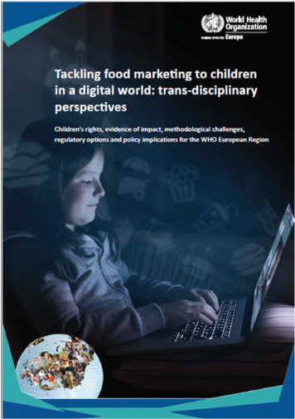

Notes:
WHO evaluating implementation of marketing recommendations. Overall shows that in Europe policies and regulations frequently apply to pre-digital media only, younger children, narrow definitions, strong opposition and scrutiny from private sector, weak self-regulatory schemes.
Angela
Set of recommendations provided: government action, marketing to cover other commercial communications, reduce both exposure of children to marketing and the power of such marketing, comprehensive approach, monitoring and enforcement required

Slide 18
Contact Information
For information or to get involved
TWITTER
TWITTER
@HealthyAuckland
EMAIL ADDRESS
healthyaucklandtogether@adhb.govt.nz
Notes:
Angela
Handouts: Copies of code, how to guide
One copy of the FBCS guide

